Slide 1
Road to the Common Core
Plainfield Community Consolidated School District 202
Notes:
Glenn
Welcome
Introductions
Organizational Items:
45 minute time limit
Handouts at end of presentation: FAQ’s, Specifics for ELL/ IEP students, Parent Handouts with specific recommendations, D202 Road map
?’s @ End
Recorded put on website and handouts as well
Introduce Lynn, Michelle, Cathy
Sample Problems – No multiple Choice, Hard to Guess, What did you think?
Overview:
The Common Core itself has the potential to be a positive force for our, but its impact will be determined by how it is implemented in schools and classrooms across the country.
Implemented in District 202 :
Students will be self directed, problem solvers better prepared for the world or work or college.
Content – Critical Thinking, Creativity, Curiosity
Character – Self-discipline, Perseverance, Academic Resilience
Parents
Encourage perseverance, resilience, problem solving.
Purpose:
Update on D202’s Progress:
1) What does Common Core mean for the children in District 202?
2) District 202’s preparation for Common Core
3) How Parents/Community can support children.

Slide 2
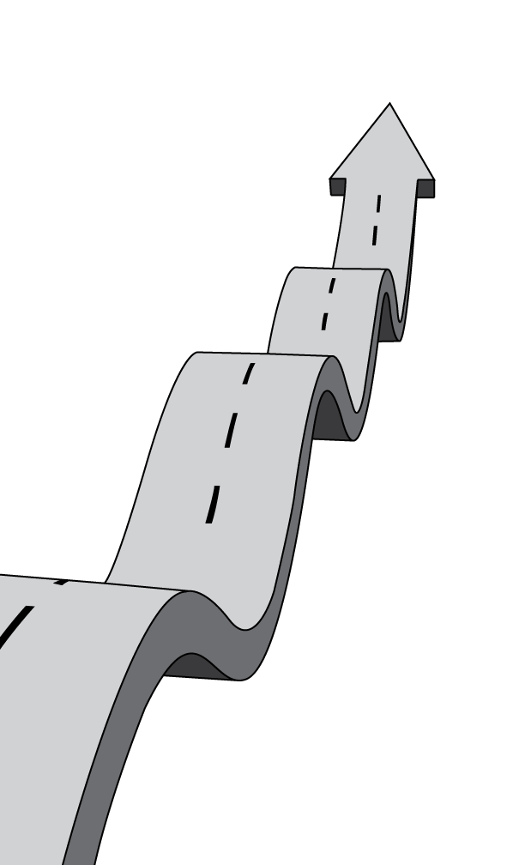
TIMELINE to PARCC
Spring 2015 Illinois On-Line PARRC Testing
August 2014 D202 Implement ELA CCSS
August 2013 D202 Implement Math CCSS
June 2010 Illinois Adopts CCSS
June 2010 NGA Adopts CCSS
2001 ESEA (No Child Left Behind) Authorized
Notes:
Glenn
In a recent survey on public education by Phi Delta Kappa and Gallup:
62% of respondents to a national survey on public education hadn’t heard about the common core.
55% of public school parents did not know anything about the new standards.
To understand how Common Core came about it is necessary to understand its roots.
No Child Left Behind President Bush’s education law required all states that received federal education funding to develop standards and tests in grades 3-8 and once again in high school. AYP
Under No Child Left Behind states established assessments with different proficiency levels and standards. Some states had easier tests than others.
In response to this, the National Governors Association developed a common set of standards that all states would agree to join.
Governors and State Superintendents enlisted experts to draft and review the standards before opening them up for public comment and finalizing them.
The National Governors Association released the Common Core standards on June 2, 2010.

Slide 3
Fewer, Clearer, Higher Standards
Notes:
Glenn
Since then, 45 states, four territories, the District of Columbia, and the Department of Defense Education Activity voluntarily adopted the Common Core State Standards. Minnesota only adopted the English language arts standards. Alaska, Nebraska, Texas, and Virginia have refused to adopt the Common Core.

Slide 4
Notes:
Glenn
According to 2013 ACT data measuring college readiness benchmarks only 1 in 4 Illinois high school students graduates ready for to be successful in college or a career.
The Common Core emphasizes skills that students need to succeed in college and the professional world. Because the Common Core is benchmarked with international standards, students will be well-equipped to compete in today’s global economy. Ultimately, the Common Core will better prepare students for postsecondary education and the workforce.
What are the National Common Core State Standards?
The Common Core State Standards (CCSS) are a set of shared K-12 learning expectations for students in English-language arts and mathematics.

Slide 5
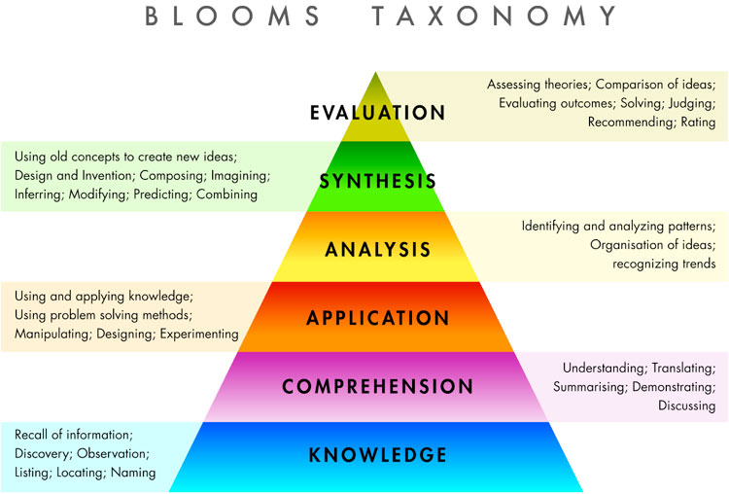
Rigor, Higher Order Thinking
http://www.bing.com/images/search?q=blooms+taxonomy&view=detail&id=11CCB05590572968B326850E7333A4D062B9AE69&first=1&adlt=strict
Notes:
Glenn
More rigorous content and application of knowledge through high-order skills
Blooms Taxonomy : classification of learning objectives for students.
Sample problems at the beginning of presentation.

Slide 6
PARCC Assessments 2014-15
2 Tests (75%,90% of year) in ELA and mathematics, Gr. 3-11
On the computer
Increased amount of time from ISAT/PSAE
Notes:
Glenn
There is more to the Common Core than just standards
The Common Core’s standards are paired with assessments to measure students’ learning, and they will replace the current state-level exams.
In Illinois, students will take the Partnership for Assessment of Readiness for College and Career (PARCC) assessment .
PARCC is made up of 19 states + DC and US Virgin Islands
PARCC will have two assessments each school year instead of the ISAT and PSAE for the 2014-15 school year.
Performance Based – ¾ of year - Extended tasks, Applications of concepts and skills,
End-of-year – 90% of instruction, Innovative, computer based items.
Increased amount of time from ISAT/PSAE
2 Hours more in 3rd Grade, 3 Hours more in 4th – 11th
Technology allows for more rigorous testing:
New test technology allows students to:
design products or experiments, to manipulate parameters, run tests, and record data.
Assessment questions can incorporate audio and video. Problems can be situated in real-world environments, where students perform tasks or include multi-stage scenarios and extended essays.
Additionally, the SAT, ACT, and GED will be redesigned to align with the Common Core.

Slide 7
Adopted CCSS 2010
Pending Waiver Application NCLB 2012-2013
Changed ISAT (Grades 3-8), FY13/FY14
Notes:
Glenn
June 2010 ISBE Adopted Standards
Summer 2012 ISBE Applied for Waiver from No Child Left Behind. 39 states have been approved. Illinois has not. Student Growth on Teacher Evaluation.
Spring 2013 K-8 ISAT Assessments – 20% CCSS Items, Raised Cut Scores, Scores required to pass were boosted by 13 to 30 points
Across the state scores dropped significantly. District 202’s scores dropped also but showed 10% less of a decline in Reading and Math Compared to state.
Spring 2014 K-8 ISAT Assessments – 100% CCSS Items, Raised Cut Scores
As state have adopted a number of concerns have been echoed.
Introduce Lynn
Concerns
Reflections/Feedback:
Students
Teachers
Parents

Slide 8
Concerns
Notes:
Lynn
1) As the PARCC assessment gets closer to full implementation the Common Core has become more politicized
Conservative critics say it is an intrusion from the federal government. The standards were adopted by the states, but the Obama administration has strongly supported the effort.
Liberals are concerned with the amount of testing and the collection of information on students.
2) State legislators are getting more pushback from community members.
3) Teachers, and teacher unions believe that the standards and the assessments aligned with them are being implemented too quickly.
4) Implementation cost of the standards becomes evident, many adopting states are scrambling to delay or defund implementation.
5) Implementation issues regarding technology has two states, Alabama and Oklahoma, have already withdrawn from their testing consortia and will work independently with test providers to develop assessments for their students.

Slide 9
High School Teacher Feedback
Notes:
Lynn
Reflections/Feedback:
Students
Teachers
Parents
Teachers have noticed increased rigor, stressed,
Teachers: Specific needs - ELL/SPED
Teachers: Longer wait time, longer think time, Toes in water

Slide 10
Plainfield 202 Common Core Timeline
Content | 2011-2012 | 2012-2013 | 2013-2014 | 2014-2015
Math | Alignment | Adjust Resources Assessments | Implement K-10 | Implement, K-12
ELA |  | Alignment | Adjust Resources Assessments | Implement K-12
Science |  |  |  | Alignment
Social Studies |  |  |  | Alignment
Notes:
Glenn
The Common Core itself has the potential to be a positive force in education, but it will rise and fall on how it is implemented in D202.
Common Core is a set of standards, not a curriculum
If you imagine standards as a destination, the curriculum is the map to get there.
A curriculum outlines the sequence of topics that teachers will cover on their way to the final goal of the standards, building from simpler tasks to more difficult and complex ones.
District 202
Inclusive Process to Create Curriculum that implements Standards
Ongoing, Pro-Active Communication plan for two years to share with our community
Learned a lot and continue to learn along the way.
Years to fully implement.
Validation this year
Ongoing PD for staff
Teachers:
Develop engaging lessons based on best practice.
Collaborating on lesson plans and exchanging ideas about what works and what does not to create model lesson plans.
Sitting together in their school, scoring student work on rigorous, no-stakes assessments.
Introduce Michelle
Curriculum Process – SAC
Lesson Planning – Better Lesson
Reflections/Feedback:
Students
Teachers
Parents

Slide 11
Middle School Teacher Feedback
Notes:
Michelle
Curriculum Process - SAC
Lesson Planning – Better Lesson
Reflections/Feedback:
Students
Teachers
Parents
Teachers have noticed increased rigor, stressed,
Longer wait time, longer think time, Toes in water
MS - more resources, more textbooks, go find it, independently, timing
Working together more
+ mathematical practices
Move some topics around: Number Sense 1st vs. Ratios

Slide 12
Transition Considerations
ELL, Special education students
Technology On-Line Assessments
Notes:
Glenn
All students should be held to the same high expectations outlined in the Common Core State Standards.
This includes students who are English language learners (ELLs) and students with IEP’s.
However, these students may require accommodations, additional time, additional instruction, appropriate instructional support, assistive technology devices and modified assessments
Will and Do District 202 teachers have the necessary training and tools so that they can align their instruction to the new standards?
Ongoing Process
Introduce Cathy:
Resources
Professional Development – Math Capacity Builders

Slide 13
Elementary Teacher Feedback
Notes:
Cathy
Resources
Professional Development
Reflections/Feedback:
Students
Teachers
Parents
Teachers:
Teachers have noticed increased rigor, stressed,
Longer wait time, longer think time, Toes in water
Working together more
+ mathematical practices
Parents:
EL - Math Facts
Students:
4th grade - stressing, perseverance, rigor

Slide 14
Tips for Parents
Create a quiet place for your child to study, and carve out time every day when your child can concentrate.
You should also try to sit down with your child at least once a week for 15 to 30 minutes while he or she works on homework.
Encourage perseverance, resilience, problem solving.
Notes:
Glenn
Packet 28 Suggestions that you can do to help your child available at end of presentation.

Slide 15
Notes:
Glenn
The Road to the Implementation of the Common Core in District 202 is continuing and has been filled with speedbumps along the way with more to come. We believe that this will be a multi-year process. However, working with staff and the community we believe that the implementation will be a success.
And our Students will be self directed, problem solvers better prepared for an evolving world than they have before.
Content – Critical Thinking, Creativity, Curiosity
Character – Self-discipline, Perseverance, Academic Resilience
Students can be successful.

Slide 16
Notes:
Glenn

Slide 17
PARCC
PARCC, however, will not have computer-based glossaries available in other languages. The group will allow students to use paper-based glossaries.
PARCC states will have the option to request and pay for a Spanish translation, but it will not be provided upfront.
PARCC is definitely more conventional in their approach
PARCC, on the other hand, will allow a student in any grade access to text-to-speech during the English/language arts exam if it's required by his or her IEP. But if a student uses that accommodation, score reports will contain a notation stating that "no claims should be inferred regarding the student's ability to demonstrate foundational reading skills (i.e., decoding and fluency).“
Both the PARCC and Smarter Balanced tests will also provide videos with American Sign Language for deaf students, calculators for items not testing mathematics fluency, and Braille options on portions of the test for blind students, among other supports.

Slide 18
Both groups' tests will also have embedded universal-design tools, meaning any student can zoom in, highlight parts of the test, cross out or mask answers, use an extra notepad, or even spell-check within the computer-based testing platform. Many of those tools were previously only available to students with an individualized education program, or IEP, or a Section 504 plan. (Section 504 of the federal Rehabilitation Act of 1973 prohibits discrimination on the basis of disability in schools receiving federal funds.)

