Slide 1
Road to the Common Core
Plainfield Community Consolidated School District 202
Notes:
Glenn
Welcome to Plainfield 202’s 3 Year Common Core Community Engagement Plan
Introduce D202 Staff
Organizational Items:
1 Hour time limit, 30 minute presentation, 30 minute for questions
????? Handouts at end of presentation: FAQ’s, Specifics for ELL/ IEP students, Parent Handouts with specific recommendations, D202 Road map, Website
?’s @ End
Broad Picture – CCSS/PARCC/ 3 Year Plan
Goals of Community Engagement Plan
CCSS and PARCC test are state of Illinois Initiatives
CCSS itself has the potential to be a positive force in education, but the success of our students will rise and fall on how it is implemented in school districts across Illinois.
Community relations program is aimed at focusing on the relationships of stakeholders, with an overall goal of improving student achievement.
Implemented in District 202 :
Students will be self directed, problem solvers better prepared for the world of work or college.
Content – Critical Thinking, Creativity,
Character –Perseverance, Academic Resilience
Purpose of Presentation:
Update on National / State Landscape CCSS/PARCC
Overview of D202 District 202’s CE plan Common Core / PARCC
Impact of CE plan on D202 practice
Review of National Landscape

Slide 2
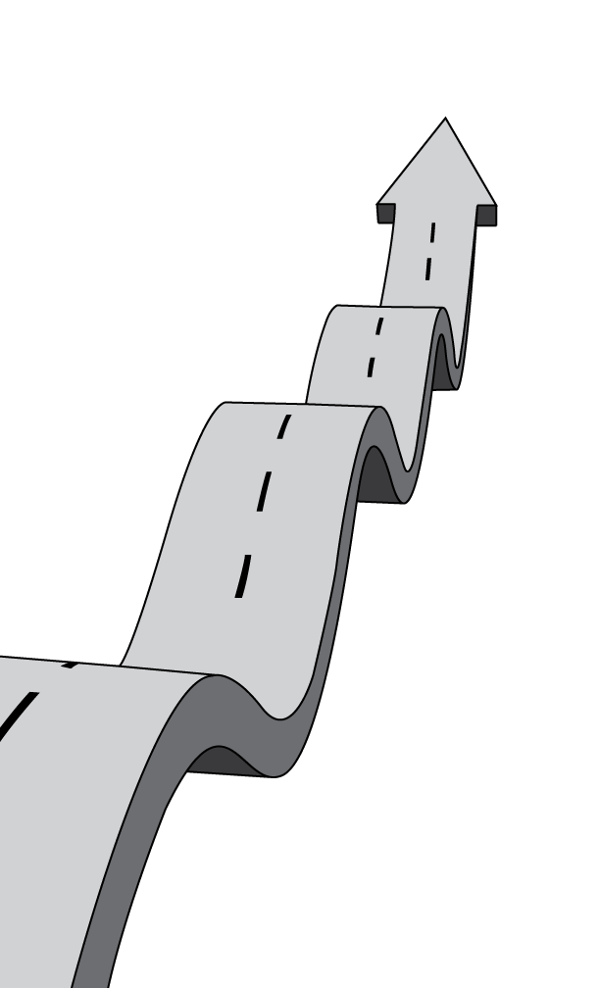
TIMELINE to PARCC
Spring 2015 Illinois PARRC Testing
August 2014 D202 Implement ELA CCSS
August 2013 D202 Implement Math CCSS
June 2010 Illinois Adopts CCSS
June 2010 NGA Adopts CCSS
2001 ESEA (No Child Left Behind) Authorized
Notes:
Glenn
Common Core arose from No Child Left Behind, D202 Implementing due to Illinois
1983 – Nation at Risk – Seminal Report not keeping up with International Competition. Calls for increased standards and a nationwide system of assessments.
1991 – America 2000 – President Bush 1st one, calls for national standards and tests. Does not pass in Congress
1994 – Goals 2000- President Clinton calls for harder standards. Does not pass in Congress.
2002 – No Child Left Behind - President Bush 2nd
No Child Left Behind President Bush’s education law required all states that received federal education funding to develop standards and tests in grades 3-8 and once in high school. AYP
Under No Child Left Behind states established assessments with different proficiency levels and standards. Some states had easier tests than others.
States reporting the highest percentage of proficient students had the lowest performance standards.
In response to this, the National Governors Association wanted a common set of standards and assessments that all states would agree to join.
Governors and State Superintendents enlisted experts to draft and review the standards before opening them up for public comment and finalizing them.
The National Governors Association released the Common Core standards on June 2, 2010.
Chris Koch, Head of State Superintendents at adoption.
Illinois Approved them in 2010. Antagonist
D202 Implement 2013, 2014
PARCC Spring 2015
As the PARCC assessment gets closer to full implementation the Common Core has received much more attention across the country and public awareness has increased.

Slide 3
August 2015
Notes:
Kevin
Who is still implementing Common Core?
43 states, four territories, the District of Columbia, and the Department of Defense Education Activity voluntarily adopted the ELA/Math Common Core State Standards.
Why Common Core State Standards?
Purpose of Common Core is to provide the English Literacy and Math skills necessary for students to compete in a 21st Century global market.
What are the Common Core State Standards?
Not Curriculum – D202 School Board approves
A set of shared K-12 learning expectations for students in English-language arts and mathematics.
Characteristics Higher, Clearer, Deeper Standards
There is more to the Common Core than just standards

Slide 4
September 2014
National K-12 Testing Landscape
Notes:
Mina
To measure students’ learning states are using a variety of assessments
In Illinois, students will take the Partnership for Assessment of Readiness for College and Career (PARCC) assessment .
PARCC is made up of 9 states + DC and US Virgin Islands – 2 Years ago it was 24 states
Arkansas, Colorado, District of Columbia, Illinois, Maryland, Mississippi, New Jersey, New Mexico, Ohio, and Rhode Island.
Currently 17 states plan to use the Smarter Balanced test this spring.
Twenty-four states have chosen other tests or are still deciding which tests to use, those 24 states enroll 58 percent of the K-12 students in the United States.
Smarter Balanced, ACT
What does PARCC look like?

Slide 5
Public Opinion 2013,2014
PDK/Gallup, Education Next
Notes:
Kevin
Support for Common Core across country has diminished the past two years
The PDK/Gallup and Education Next surveyed 6,000 American adults this past spring.
Awareness of the standards jumped in the past year as the # of people who have heard about the common core went to 81 percent in 2014, up from 38 percent in 2013.
Public – Support Slipping, perceived intrusion from federal government, called “ObamaCore”
State legislators are getting more pushback from community members.
Partisian Divide between Republicans & Democrats has grown
Politicians are using Common Core as a platform
Republican governors of Indiana & Louisiana were once supporters of Common Core
Teacher – Support Slipping, Teachers, and teacher unions believe that the standards and the assessments aligned with them are being implemented too quickly.
Despite diminishing support the majority of the country is implementing Common Core,. including Illinois.

Slide 6
Community Relations
“ Whether a school system is excellent or mediocre depends on how stakeholders work together, how they communicate, how they relate, are involved, participate and share. A community relations program is aimed at focusing on the relationships of all people, with an overall goal of improving student achievement.”
Albert E. Holliday (1988)
Notes:
Tom
A community engagement plan must be developed with short and long term goals that make the biggest impact on student achievement, are grounded in solid two-way communication techniques, and used is used as a vehicle to build trust, confidence and support for doing the best for all children in our schools.
A more engaged community results in improved teaching and learning.
Research shows a strong connection between parent and family involvement in schools and students’ academic achievement, attendance, attitude, and continued education.
The implementation of the three year community engagement plan is a commitment to engage in a process by which relationships are built and strengthened to develop and apply a collective vision for the Plainfield 202 School District and the community.

Slide 7
Community Engagement Model
Notes:
Tom
Mission: Focus on relationships of people we serve to improve student achievement.
Goals:
Use as a vehicle to build trust, confidence, support
Make easy for community members to be involved
Include parents in the decision-making process
District personnel foster a welcoming environment for families
Products:
Norms of communication- external/internal
Predictable community meetings
Evolving Web Site
Communications Flow Chart
Guidelines/Procedures for website, newsletters
CORRESPONDENCE
Weekly Board E-mail
District Connection Email
Principal’s E-mail
Intranet
PA Announcement
Marquee
School Newspaper
School Newsletter
District Newsletter
Connect-Ed Message
District/School Websites
Press Releases
Key Communicator E-Mail
Initial distribution of 30,000 special “Road” fliers to all parents through Parent Teacher Conferences (November 2012)
Mass mailing/Letter from Superintendent to all district addresses (November 2012)
Flier posted on all 31 web sites/promoted in district email newsletter throughout Winter 2013 (38,000 email addresses)
First of three rounds of Community Forums Spring 2013 emph. “What’s coming…”
Press releases re: Forums to local/regional media/web sites/email news/spring 2013 newsletter; Connect-ED calls
Second round of Community Forums Fall 2013 emph. “Math Standards/teacher experience” with publicity
Third round of Community Forums Fall 2014 emph. “English Standards/PARCC” with pubilicity
Community Forums Spring 2015

Slide 8
Notes:
Glenn
Questions on Implementation, Uncertainity, Changing expectations
Nation/Illinois – Split, Resources, Tests, Training
Direction has changed, evolved
PARCC testing changed Aug. 22 Cut # of test items, reduced length of exam, tech readiness survey
The Common Core itself has the potential to be a positive force in education, but the success of our students will rise and fall on how it is implemented in school districts across Illinois.

Slide 9
Plainfield 202 Common Core Timeline
 | 2011-2012 | 2012-2013 | 2013-2014 | 2014-2015 | 2015-2016
Math | Align | Resources Assessments | Implement K-10 | Implement K-12 | Validation
ELA |  | Align | Resources Assessments | Implement K-12 | Validation
Community |  | 4 Meetings What’s Happening? What’s Next? | 4 Meetings What’s Happening? What’s Next? | 4 Meetings What’s Happening? What’s Next?
Notes:
Glenn
District 202: Inclusive multi- year Curriculum Development Process to Create Curriculum that implements Standards
Common Core is a set of standards, not a curriculum
Standards are a destination, the curriculum is the map to get there.
A curriculum outlines the sequence of topics that teachers will cover on their way to the final goal of the standards, building from simpler tasks to more difficult and complex ones.
D202 – Curriculum, Assessments, Feedback, Professional Development, Resources
Cursive, spelling
Process allows Change, Respond
MS - more resources, more textbooks, go find it, independently, timing
Move some topics around: Number Sense 1st vs. Ratios
Throughout this process our students, teachers, and administrators have learned a lot and shared things that guide our work in the future.

Slide 10
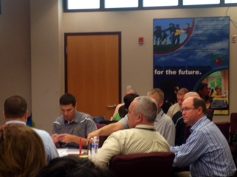
Students
Teachers
Principals
Notes:
Mina
When fully implemented in District 202:
Our Students:
will be self directed, problem solvers more prepared for an evolving world than they have before.
Content – Critical Thinking, Creativity, Curiosity
Character – Self-discipline, Perseverance, Academic Resilience
Our Teachers:
Collaborate and create model lesson plans.
Exchanging ideas about what works and what does not
Ongoing PD for staff
Teachers have noticed increased rigor, stressed, working together more
Longer wait time, longer think time
Our Principals:
Look fors, teacher support
Ongoing PD
What does this mean for School Board members?

Slide 11
Notes:
Kevin
Believe in system, process, people, accept changing landscape.
Focus on students rather than policy
Emphasize that the standards will help students succeed in college and careers
The new standards emphasize the high-level, core skills that students will need in the future to be successful in college and careers.
The common core encourages students to read the kinds of material they will see in the workplace, along with literature and history.
Test Scores will decline. Proficiency rates on new assessments may not be comparable to previous assessments.
Lower test scores do not mean that students have learned less or fallen behind academically.

Slide 12
Notes:
Glenn
The Road to the Implementation of the Common Core in District 202 is continuing and has been filled with curves and speedbumps along the way.
This is a multi-year process.
Tips for Parents
New- math
Create a quiet place for your child to study, and carve out time every day when your child can concentrate.
You should also try to sit down with your child at least once a week for 15 to 30 minutes while he or she works on homework.
Encourage perseverance, resilience, problem solving.
There are no easy answers. Across the country school districts are building the car while driving to the Common Core.
We believe higher, clearer, deeper standards are good for students and D202 is involving the right people, taking the proper steps, and continue to work to insure our students will be successful.
?’s

Slide 13
Notes:
The Common Core State Standards(CCSS) have the potential to be a positive force in education, but the success of students will rise and fall on how the standards are locally integrated into curriculum, instruction, and assessment in school districts across Illinois.
Why ? What is CCSS and PARCC ?
The Common Core State Standards initiative was led by the National Governor’s Association (NGA) and the Council of Chief State Schools Officers (CCSSO) and established a single set of clear educational standards for kindergarten through 12th grade in English language arts and mathematics. Raising standards for students is not a new. A number of federal initiatives have attempted to raise standards and improve student achievement including a Nation at Risk (1983) to No Child Left Behind (2002). Under No Child Left Behind states established assessments with different proficiency levels and standards.
In response to states lowering their standards to more easily meet NCLB progress goals the National Governors Association wanted a common set of standards and assessments that all states would agree to join. Governors and State Superintendents of Education enlisted experts to draft and review the standards before opening them up for public comment and finalizing them. The National Governors Association released the Common Core standards on June 2, 2010; later that month Illinois adopted the standards. By 2011, encouraged by the federal Race to the Top initiative, forty-five states adopted the benchmarks that detail what students should learn at each grade level.
Beginning in the 2014-2015 school year Illinois students will take the Partnership for Assessment of Readiness for College and Career (PARCC) assessment to measure their learning. As the PARCC assessment gets closer to implementation the Common Core has received much more attention.
The change to the CCSS standards in American classrooms stayed mostly out of the public radar until 2013 where backlash began to grow in states like New York, where new Common Core tests had sent scores plummeting, and Indiana, where conservatives were leery of the Obama administration’s support of the standards.
In early 2014 the changes in American classrooms began to hit mainstream as CCSS was a topic on Facebook, Twitter, YouTube, and material for television pundits and comedians.
The public opposition has been voiced both by bi-partisan political groups who fear expanded federal control and by teachers unions worried about the consequences for teacher evaluation. State legislators have received pushback from community members and politicians are using Common Core as a platform.

Slide 14
12/9/14
Notes:
Support for CCSS Slipped
Indiana, Missouri, Oklahoma, North Carolina and South Carolina have all dropped Common Core standards after initially adopting them, and Missouri, North and South Carolina are still using the standards while they develop alternatives. Alaska, Nebraska, Texas and Virginia never adopted the standards. In 2014 there were 77 bills introduced in state legislatures to limit or halt implementation of Common Core, with more expected next year.
While most states remain committed to the standards, a number of public polls share that support for the Common Core State Standards slipped noticeably between 2013 and 2014.
http://www.realcleareducation.com/articles/2014/12/09/common_core_future_elections_heat_map_1140.html#map

Slide 15
Notes:
Publishers, school districts and teachers have mostly been left to their own devices to figure out how to meet the higher demands of Common Core. Since adoption in June 2010 school districts have taken different approaches to resources and professional development. Some districts have assembled their own curriculum from scratch, others have spent money on newly developed curriculum materials.

